Slide 1

BCA MINOR PROJECT PRESENTATION 2022-2023
STUDENT INFORMATION SYSTEM
by
HIMANSHU KR. SHARMA , AKSHAY KUMAR ,
RASHMI MANDAL , VARTIKA SRIVASTAVA
Under the guidance of
DR. AMRITA SARKAR
Department of Computer Science and Engineering
Sarala Birla University, Ranchi, Jharkhand 835103

Slide 2
CONTENT
1. Introduction
2. SIS involves
3. Frontend (Language used)
4. Backend (Language used)
5. Methodology
6. Requirement
7.Use Case
8. System Security Analysis
9. Student login process flowchart
10. Discuss About E-R
11. User login Diagram
12. User Interface of SD
13. Conclusion
14. Future Scope

Slide 3
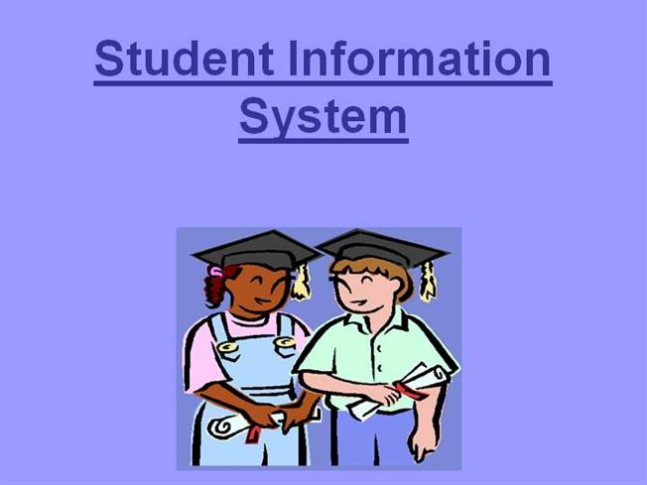
INFORMATION
A Student information system is a system that manages the records of student regarding examination , fee , attendence etc.
SIS is a managment information system for education sector establishments used to manage students academic data.

Slide 4
SIS INVOLVES
Exam scheduling
Result checking
Attendence
Syllabus
Day to Day Classes Updates
Assignment

Slide 5
FRONT-END (LANGUAGE USED)
HTML (Hypertext Markup Language)
It is the standard markup language for creating web pages.
CSS (Cascading Style sheets)
It is a computer language for laying out and structuring web pages .
JS (JavaScript)
It is a text-based programming language used both on the client-side and server-side that allow you to make web pages interactive.
Bootstrap
It is free, open source front-end developmemt framework for the creation of websites and web apps
JQuery
“write less,do more”,javascript librabry.

Slide 6
BACK-END (LANGUAGE USED)
EXPRESS.JS
Express is a node js web application framework that provides broad features for building web and mobile applications.
NODE.JS
It is an open source , cross-platform runtime enviroment for executing Javascript code.

Slide 7
METHOOLOGY
ANALYSIS AND DESIGN
IMPLEMENTATION
DEPLOYMENT
TESTING
EVALUATION
PLANING
REQUIREMENT

Slide 8
REQUIREMENTS
This system is mainly used by admin, teachers , and students in the colleges , universities and also others educational insititues.
There will have basic and stable information specification settings.
Supporting data update, modify and adjustment.

Slide 9
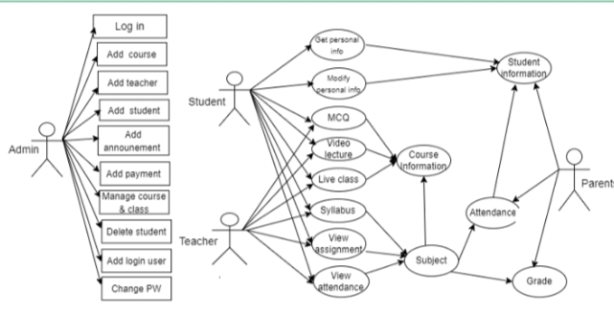
USE CASE DIAGRAM

Slide 10
SYSTEM SECURITY ANALYSIS
In the development process of student information the security analysis is an important link and guarantee for operate and maintenance of the system. After the successful development of system, it contains and protection the basic information and student application information of students assisted by their colleges and universities. During use this process , the system will save in the information container.

Slide 11
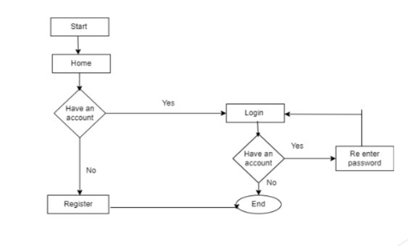
STUDENT LOGIN PROCESS FLOWCHART

Slide 12
DISCUSSED ABOUT E-R
E-R Diagram its full meaning is Entity Relationship Diagram. E-R is a diagram that used to represent the relationship between entites. It has mainly three parts these are Entity, Realtionship, Attributes. The E-R diagram shows the relationship of entity sets stored in a databases. There is a certain relationship between the various entites of the system, students apply, teacher statement, checking, students fund there are many types of useful functionality projects.

Slide 13
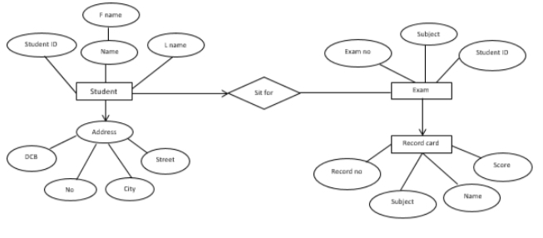
E-R DIAGRAM FOR SIS

Slide 14
USER LOGIN DIAGRAM
According to the application system, user login to enter their student information system. Only put correct direction then you can enter the system successfully by selecting the permission and entering the Username and Password if you have already. After successfully login , the page will jump to the corresponding main interface. If the username or password is entered incorrectly, the system will not enter next steps .

Slide 15
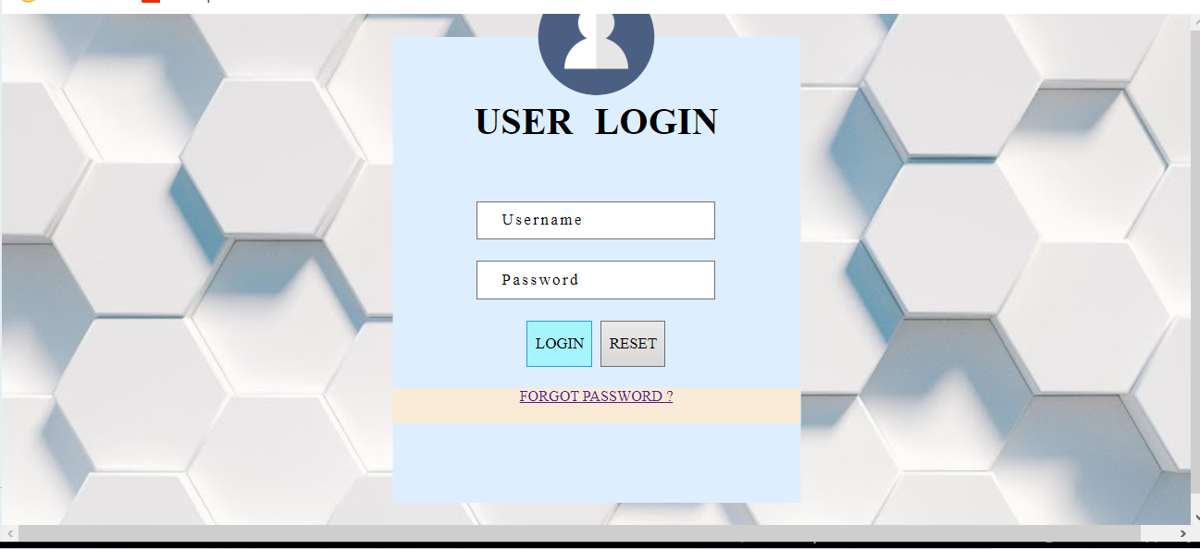

Slide 16
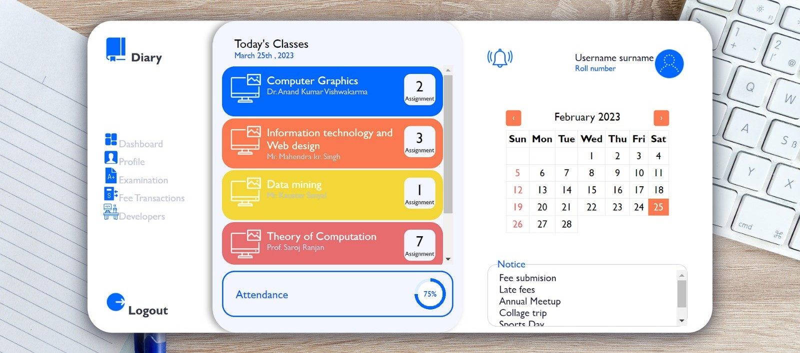
USER INTERFACE OF SIS

Slide 17
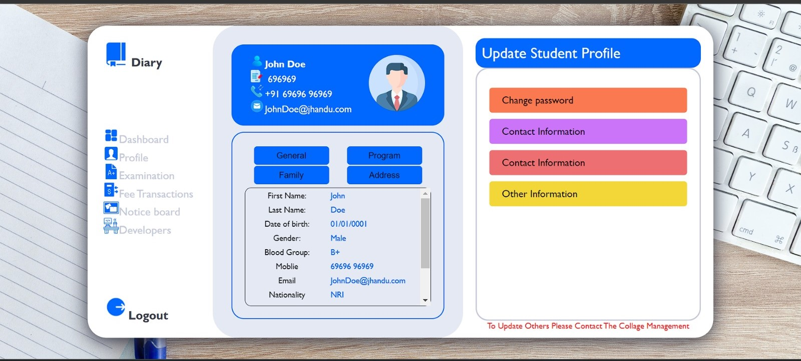
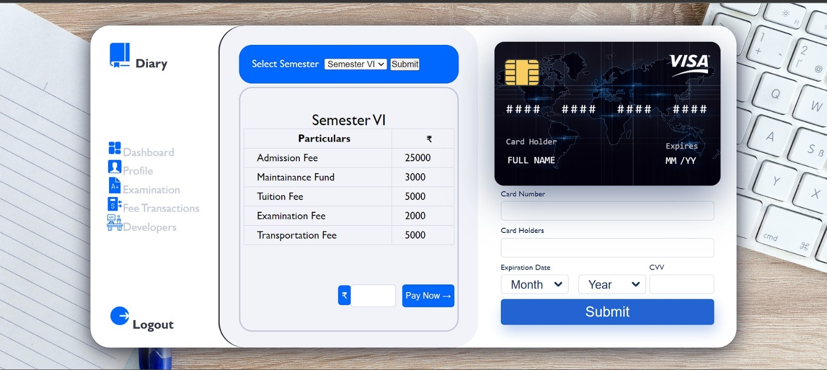

Slide 18
CONCLUSION
Helpful to perform paperless work and manage academic data.
Data provides easily and accurately
faster data access
Getting Valuable necessary announcements

Slide 19
FUTURE SCOPE:-
In the future students can also be able to upload or download notes.
We will see the entire system more interative and also be able to give statistics data.
We can run the entire sysyem in any operating system and also we have an android application of this entire system.

Slide 20
Thank You……!

